Slide 1
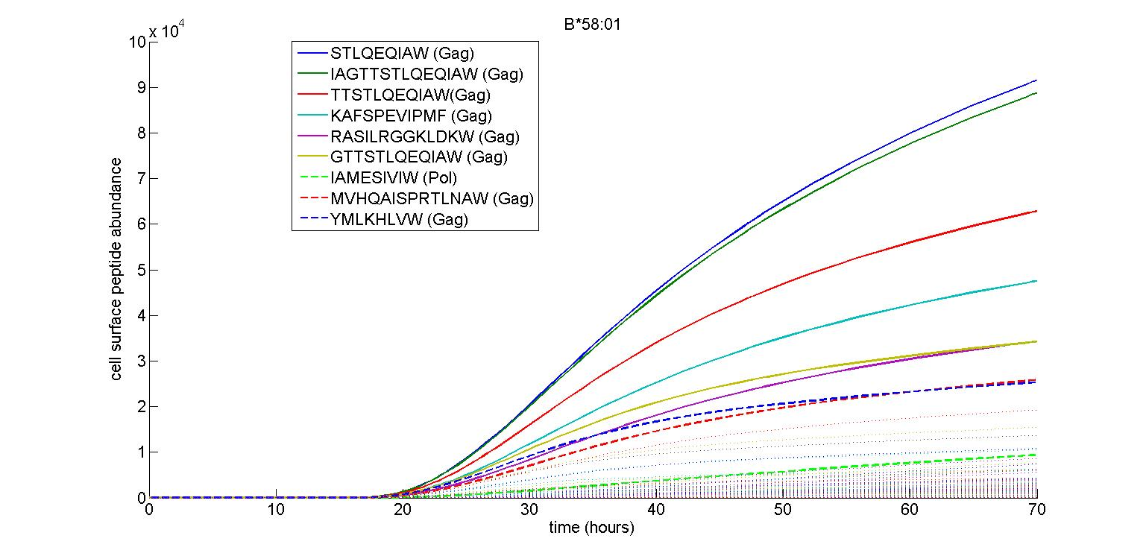
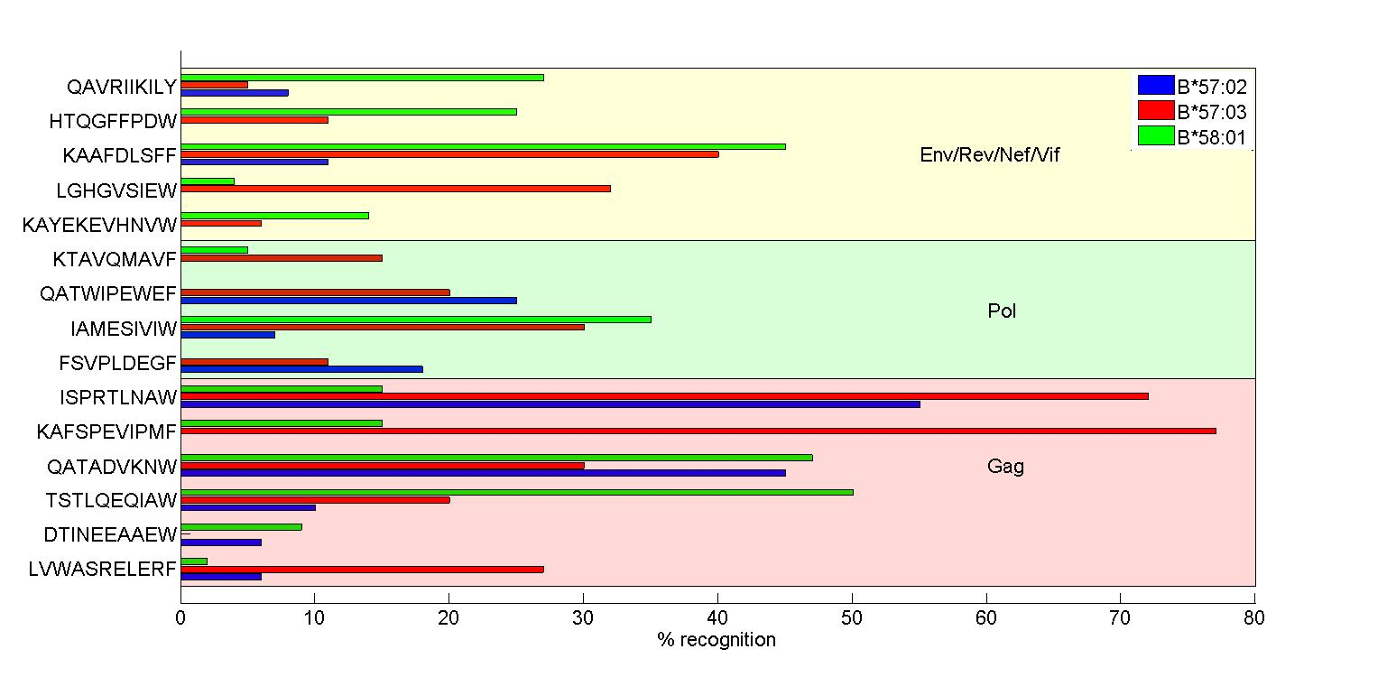
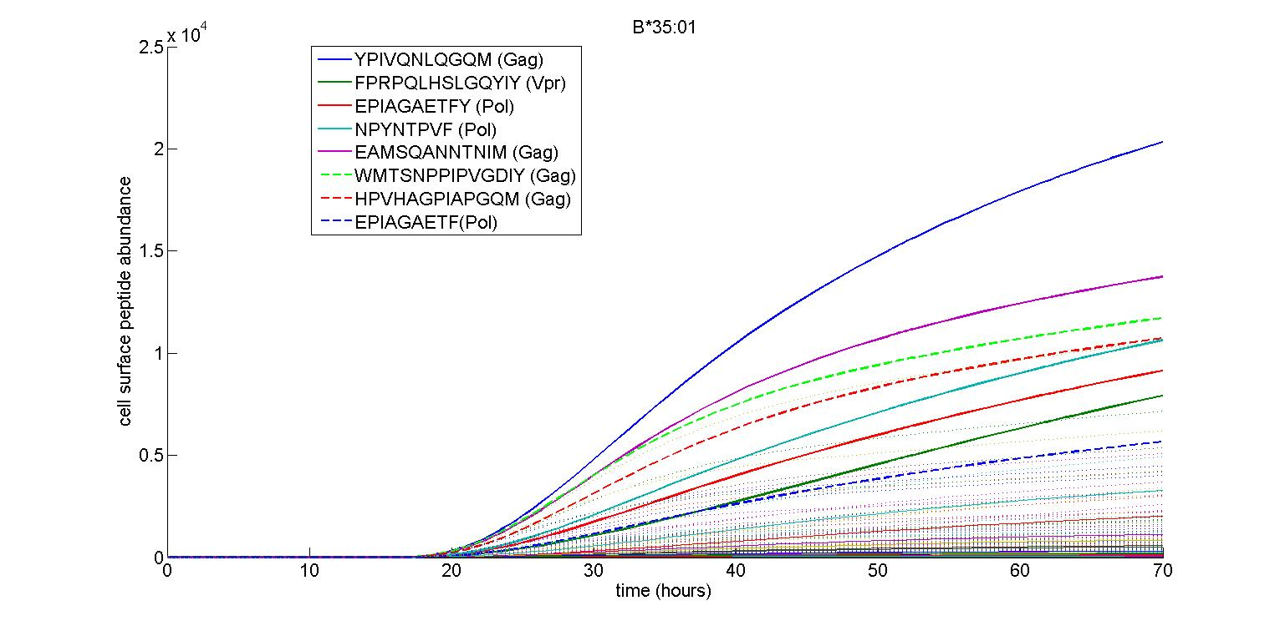
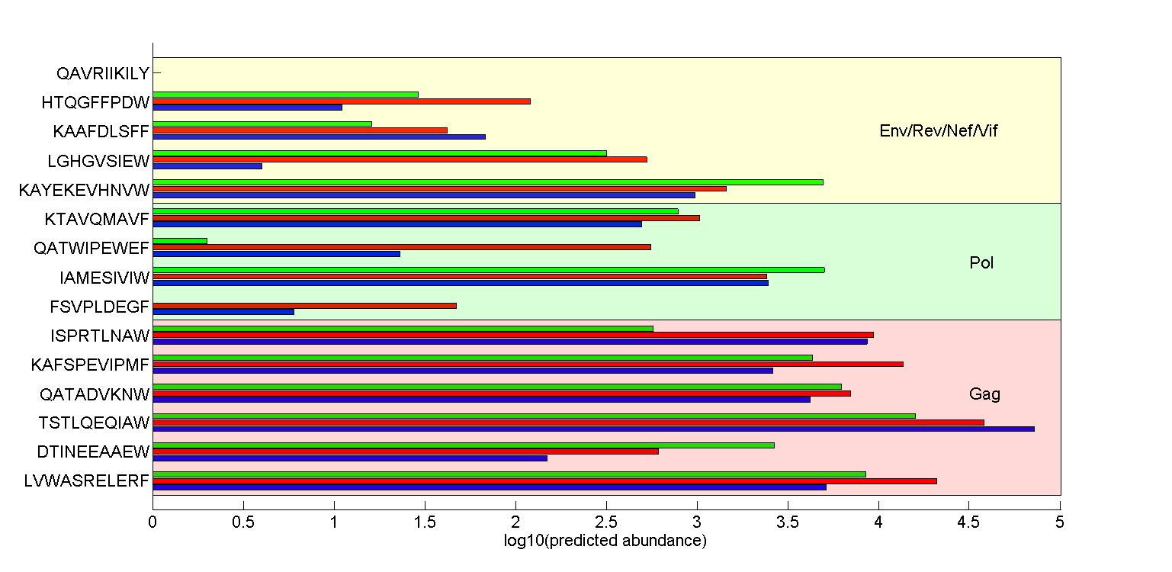
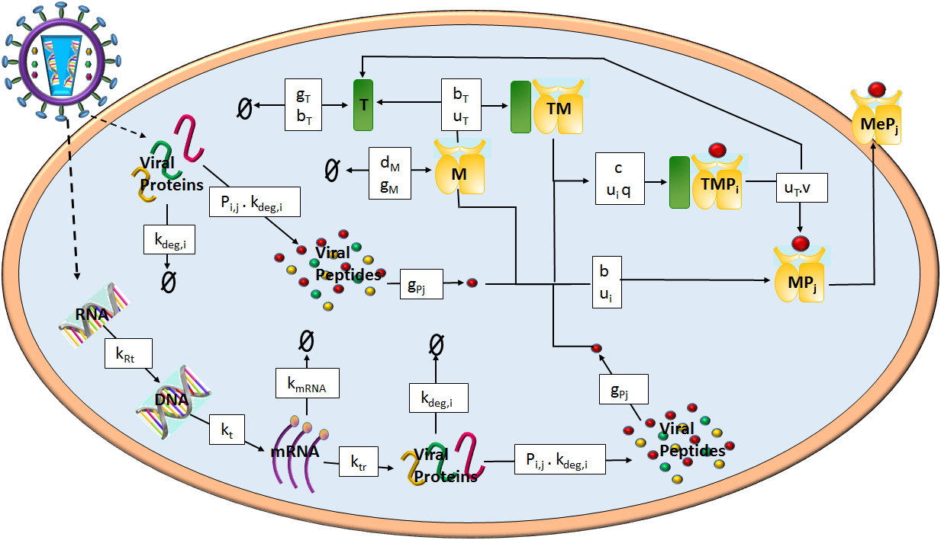






Predicting the Cell Surface Presentation of Viral Peptides by MHC Class-I Molecules
Ruth Charlotte Eccleston¹, Neil Dalchau², Peter Coveney³
1. CoMPLEX, UCL, Gower St, WC1E 6BT, 2. Microsoft Research , 21 Station Rd,, CB1 2FB 3.Department of Chemistry, UCL, Gower St, WC1E 6BT
Introduction
The progression rates of infection from human immunodeﬁciency virus (HIV-1) to acquired immune deﬁciency syndrome (AIDS) varies between individuals, and is inﬂuenced by a part of the human genome known as the Major Histocompatability Complex (MHC). The MHC proteins allow the immune system to survey the protein content of cells by presenting small fragments of these proteins, known as peptides, on the cell surface. Here we show how a mathematical model of HIV antigen presentation can be used to explain how immune responses to HIV depend on MHC-peptide binding and the efficiency of peptide processing for different amino acid sequences.
Results 1: Controllers vs non-controllers
Results 2: Cell surface abundance vs T-Cell response
The alleles HLA-B*57:02, -B*57:03 and –B*58:01 are all associated with HIV control, however HLA-B*57:03 is associated with a significantly lower viral load than the other two alleles [1]. Comparison between the T-cell response to 15 HIV peptides (measured in Kloverpris et al [1]) with the simulated abundance found that the rank order of abundance can directly explain the order of percent recognition for 4 peptides (those marked by a ), whilst a general positive correlation between abundance and response is observed for 6 other peptides (those marked by a ). The percent response for the remaining 5 peptides could not be explained by the predicted abundance (those marked by a ). This is particularly important with regards to KF11 Gag and ISW9 Gag which are presented in highest abundance by B*57:03 and are also associated with the highest percent recognition.
Comparison between the predicted presentation of HIV peptides by HLA alleles associated with control vs alleles associated with progression of the disease suggests that:
Controlling alleles, such as B*58:01, present peptides in much higher abundance than non controlling alleles, such as B*35:01 (Figure 2).
The cell surface distribution of controlling alleles is dominated by a wide range of Gag peptides at high abundance, whereas the non-controlling alleles also presented peptides from other HIV proteins, such as Pol, in high abundance. The presentation of a wide range of Gag peptides is known to be associated with control of HIV [2].
Furthermore, the model predicted the presentation of known epitopes, such as KF11 (KAFSPEVIPMF) Gag, and IW9 (IAMESIVIW) Pol, which are known epitopes of B*58:01 [1].
Modelling presentation of HIV peptides
Viral peptides are thought to be produced in a mostly analogous way to non-viral peptides, via intracellular protein degradation. Viral proteins can either come from the entry of the virion in to the cell, or be synthesised by the host cell. Peptides are transported from the cytoplasm to the Endoplasmic Reticulum via the transporter associated with antigen processing (TAP) where it can bind with MHC molecules and egress to the cell surface. Peptides are then selected based on their stability for MHC class I molecules, prior to eventual egression to the cell surface. Cell surface abundance thus depends on intracellular abundance, ER transport and MHC affinity.
To quantify how each of these factors contributes to viral peptide presentation, we combined an existing model of HIV intracellular kinetics with a model of peptide presentation. Biochemical interactions were modelled by a system of ordinary differential equations. The main interactions are illustrated in Figure 1. The HIV genome encodes 9 proteins: three structural proteins, Env Gag and Pol, two regulatory genes Tat and Rev, and four accessory proteins, Vif, Vpu, Vpr and Nef. The amino acid sequences of these proteins were used to predict which peptides would be produced using existing machine learning algorithms, which predict the affinity of peptides to HLA alleles, as well as their proteasomal cleavage probabilities.
Figure 2: The presentation kinetics of HIV peptides was simulated using a model combining HIV intracellular kinetics and MHC presentation and online machine learning algorithms. Example simulations are shown for a) B*58:01, a controlling allele and b) B*35:01, a non-controlling allele.
Figure 3: a) The recognition of 15 HIV peptides was tested in IFN-γ ELISPOT assays and represented as the percent of subjects who recognised the peptide. The data plotted is presented in Kloverpris et al. 2012 [1]. b) The predicted cell surface abundance of the 15 HIV peptides at 72 hours post infection by the three HLA alleles B*57:02, B*57:03 and B*58:01.
Conclusions
It is well known that Gag peptides are associated with control of HIV [2]. The model predicts that controlling alleles present HIV peptides at higher abundance than non-controlling alleles, and that the majority of these high abundance peptides originate from Gag. The comparison between the simulated abundances and the percent recognition data suggests that the a high cell surface abundance increases the likelihood of an immune response. However, exceptions to this rule, such as TW10 Gag, suggests that other factors influence T-cell response, such as the allele which is presenting the peptide.
References
[1] Kloverpris H N, et al. 2012. HLA-B*57 Micropolymorphism Shapes HLA Allele-Speciﬁc Epitope Immunogenicity, Selection Pressure, and HIV Immune Control. Journal of Virology, 86(2):919–929.
[2] Matthews P C, et al. 2012. Differential Clade-Specific HLA-B*3501 Associations with HIV-1 Disease Outcome Is Linked to Immunogenicity of a Single Gag Epitope. Journal of Virology, 86(23):12643-12654.
Figure 1: Main components required to model peptide presentation. Viral peptides originate from the cytoplasmic degradation of both virion associated and host-synthesised viral proteins. Once transported in to the ER peptides can bind to MHC molecules and be presented on the cell surface.

